Slide 1
Advanced Cardiac Life Support
November 19 & 20, 2015
for
Respiratory Therapists

Slide 2
What is ACLS?
Introduction to the management arresting and life threatening arrhythmias
Management of the first 10 minutes of a V-fib/pulseless VT arrest
Management of arrested algorithms
Recognition and inital treatment of life threatening life threatening arrythmias

Slide 3
What ACLS is NOT
Certification to do any of the tasks
Certification to administer any of the medications
Certification to manage a cardiac arrest

Slide 4
Why Take ACLS?
RTs throughout world respond to cardiac arrest as part of the base job description.
RTs are integral members of the cardiac arrest team.
Roles/expectations of RTs at arrests are varied, but generally expanding.
Even if role is “traditional” you should still know what others are doing, so can effectively work as a team.

Slide 5
ACLS
Science reviewed and guidelines updated every 5 years.
Last Update was released in October of 2015
Your books are hot off the press

Slide 6
ACLS 2015
Little change from 2010
CPR CPR CPR
Watch O2 with people with a pulse

Slide 7
Take a CAB to an arrest
Most arrests cardiac
Less than 20% arrests get cpr
Starting with compressions my eliminate initial reluctance

Slide 8
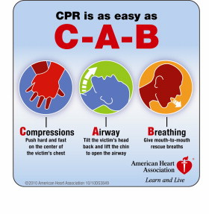
ABC vs CAB

Slide 9
CPR
100-120/minute
5 to 6 cm depth
Allow recoil
Minimize interruptions
Avoid excess ventilation

Slide 10
The numbers
30:2
100-120/minute
10 breaths/minute

Slide 11
Comment
Despite the 100’s of studies little works
Arrest = CPR
Don’t stop or delay
Think of arrest as continuous cpr with a few interventions

Slide 12
CPR
Still 30 : 2
No airway adjunct pause for ventilations
Airway adjunct continuous
Defib once available
6 minute pre-hospital Compression only

Slide 13
AIRWAY
Little evidence
Urban vs rural studies
King , Combi , LMA , ETT
ET CO2 requires some sort of airway adjunct

Slide 14
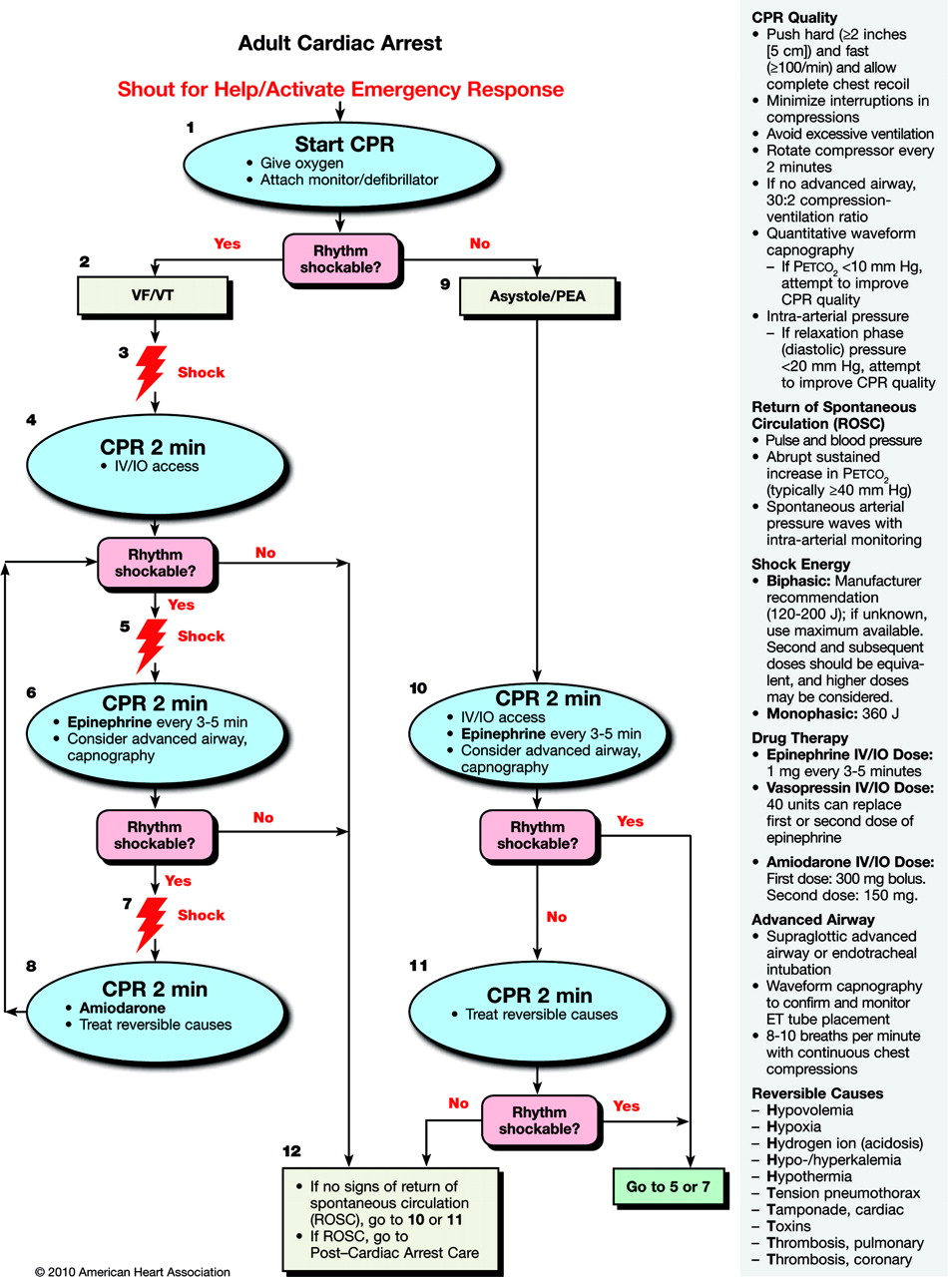

Slide 15
VF / Pulseless VT
No real change
Defib every 2 minutes
Alt epi 1mg with Amio
Amio dosing 300 push then 150 push

Slide 16
ROSC
Movement
Increase ET CO2
Increase arterial wave form
Pulse at pulse check

Slide 17
Prognosis
ETCO2
CPP
CV O2
Ultrasound

Slide 18
End tidal CO2
< 10 bad
Flag to improve quality of CPR
Early marker of ROSC
May reduce some of the risk of giving epi to someone with a pulse

Slide 19
End tidal
False +ve
False -ve
Carbonated drinks
HCO3
Massive PE
Low /no output (dead)
Severe airway obstn/asthma

Slide 20
DRUGS
Epi
Amio
Vasopressin & Steriods
Mg
HCO3
Atropine
Lytics
lidocaine

Slide 21
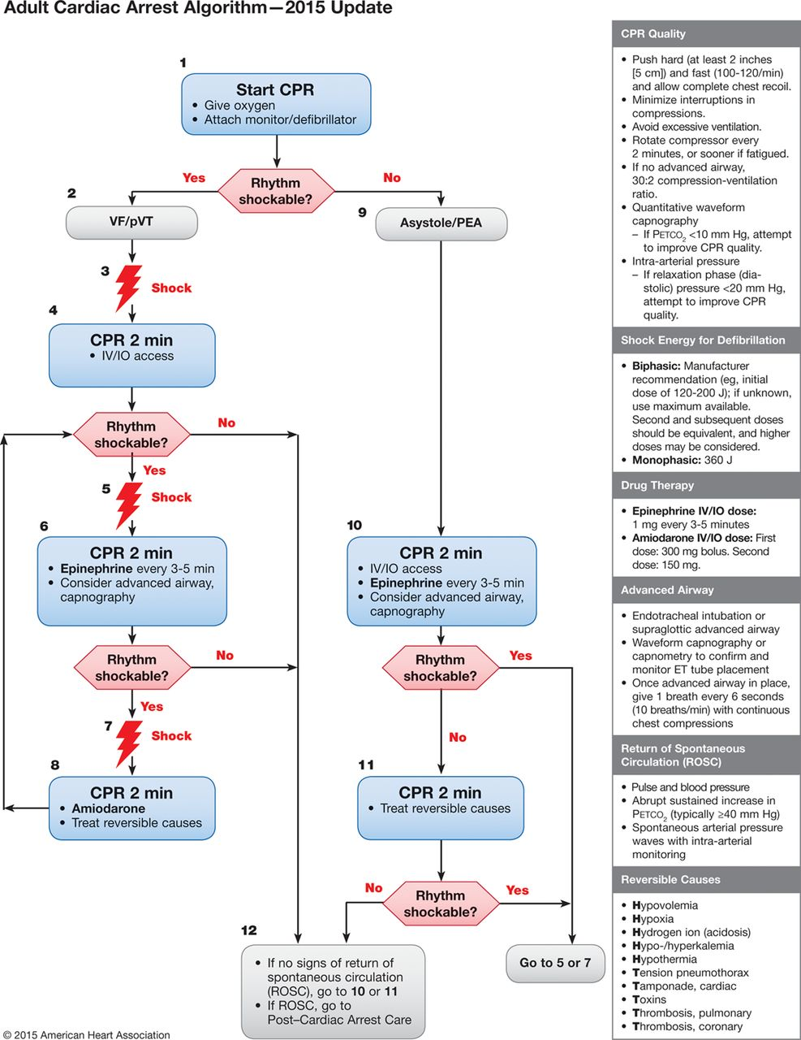

Adult Cardiac Arrest Algorithm―2015 Update.
Mark S. Link et al. Circulation. 2015;132:S444-S464
Copyright © American Heart Association, Inc. All rights reserved.
Notes:
Adult Cardiac Arrest Algorithm―2015 Update.

Slide 22
PEA
H’s
T ‘s
Hydrogen
Hypoxia
Hypovolemia
Hypothermia
Hyper / hypo K
Hypoglycemia
Tablets
Tension
Tamponade
Thrombosis heart
Thrombosis lung

Slide 23
Asthma
Tension pneumo
Auto peep
Mucous plug
Airway obstruction
Permissive hypercapnea
Ketamine

Slide 24
Hyperkalemia
Slow wide complex
Calcium
Bicarb
Insulin / glucose
Ventolin
Kayexalate

Slide 25

Hyperkalemia

Slide 26
Toxins
Beta blockers
Calcium channel blockers
Digoxin
TCA’s

Slide 27
Pulmonary Embolus
Lytic question
High risk situation

Slide 28
Tachycardia and Bradycardia
Stable vs Unstable
Low BP
Decreased LOC
Signs of shock
Ischemic Chest Pain
Acute Heart Failure

Slide 29
Tachy options
Adenosine now permitted WCT
Watch physiologic compensation
Stable vs unstable
Beware irregular / wide

Slide 30
Electrical Therapy
VF/VT no pulse – go high
A.fib 120-200
SVT 50-100
Stable VT 100
No pad position better

Slide 31
AED”s
If shocked within 3-5 minutes survival 41 -74%
PAD trial +ve
Ontario 2600 aed’s – 25 saves this year

Slide 32
Bradycardias
Stable vs unstable
if unresponsive to Atropine
Choice of Pacing vs inotropes
Dopamine
Epi

Slide 33
Alternate CPR’s
Vest
Thumper
IACPR
Suction
Evidence not conclusive

Slide 34
Post Arrest
Airway
Brain assessment – hypothermia
? Lytics /cath lab intervention
CO = SV x HR
Optimize hemodynamics
Keep SpO2 >94%

Slide 35
Special Arrests
Require additions / deviation from ACLS
Need to happen quickly

Slide 36
Anaphylaxis
Tube early
Volume
IM epi if line delayed
vasopressors

Slide 37
Pregnancy
IVC compression
Magnesium sulfate toxicity
PE
Abruption
Deliver within 5 minute of arrest
Protocol suggested

Slide 38
Drowning
ABC’s vs CAB
Likely hypoxic arrest
Protect neck

Slide 39
2015 review
Don’t delay CPR
Don’t stop CPR
Defib early
CPR , CPR , CPR

Slide 40
Agenda
Day 1
Day 2
3 stations
Vf/pVT
PEA
Dynamic ECG
Brady
Tachy
Mega Codes
4 stations
ACS
Hypotension
Tansport
Mega Codes

Slide 41
Agenda
Day 1
Day 2
Lunch at ~1200
Out ~ 1430
Lunch ~ 1200 Available, but no break
Testing until finished

Slide 42
Testing
Core Material (Day 1)
One on one
Conversation
Need to know life threatening algorithm
what to do
what doses to give

